Slide 1
Joint Integrated protection system (JIPS): Systems engineering Plan (SEP) Internal program review (Ipr) 1
Team 1:
Chris Aall, Ryan Altenbaugh, Kimberly Battle, Steve Mazza, Liz Swisher, Maranatha Zopfi
1 Aug 2012

Slide 2
IPR 1 Agenda:
Program Summary: Required Capabilities
Stronghold System Description
SWORDS System Description
Program Summary: Operational Concept Description
Program Summary: Overall Goals – Manufacturing & Development
Systems Engineering Process
High Risk Areas
Recommended General Approaches
Design Team Organization
Recommended Tools
Aspects Requiring Special Attention
2

Slide 3
Program Summary: Required Capabilities
The Joint Integrated Protection System (JIPS) shall protect permanent and semi-permanent bases in Southwest Asia from conventional and asymmetric ground attack.
The system shall integrate the Stronghold* sensor suite and C2 station, and a set of SWORDS* Unmanned Ground Vehicles (UGVs). (* Systems described in following slides)
The system shall be in full compliance with the connectivity and interoperability requirements of the Global Information Grid (GIG).
The system shall include all necessary support and maintenance documentation/procedures.
The system shall be ready for deployment in Southwest Asia by the end of 2018.
3
Notes:
Some of the top level required capabilities of the JIPS program are as follows:
This list does not contain ALL of the required capabilities, but summarizes those capabilities considered the most important and emphasized by program leaders and the end user community.

Slide 4
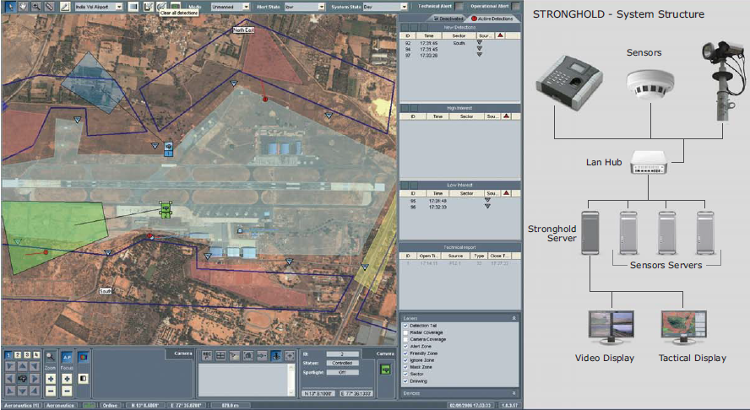
Stronghold
“A mature and operational system for perimeter security which integrates all Detection, Control and Response parameters into a single C2 management platform: Stronghold.” -Aeronautics Brochure
4
Notes:
As described earlier, one of the top-level requirements of the JIPS program was to integrate two systems, one being the STRONGHOLD. The STRONGHOLD system has been designed to serve as a platform on which all detection, control and response parameter functions are operated. As seen in the graphic presented, the basic components of the system consist of a variety of sensors, a local area network hub, the servers for both the STRONGHOLD system and sensors, a video display and a tactical display.

Slide 5
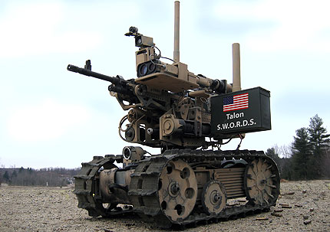
SWORDS
A weapons platform mounted on a Talon robot (a powerful, lightweight and versatile robot operable in adverse conditions and in almost any terrain) – remote controlled from up to 1,000 meters away through use of a portable Operator Control Unit providing real-time feedback for vehicle positioning.
A variety of weapon systems can be interchanged on the SWORDS – the M16, 240, 249 50-caliber machine guns or the M202-A1 with a 6mm rocket launcher.
5
Notes:
The SWORDS is a weapon platform which has been mounted on the Talon robot. In case you’re not familiar with the Talon, it is a versatile robot capable of operating under a wide range of weather conditions and can traverse over almost any terrain. It is remote controlled from up to 1000 meters away. The SWORDS basically consists of a Talon robot which has been upgraded to carry a variety of weapon systems including – the M16, 240, 249 50-caliber machine guns or the M202-A1 with a 6mm rocket launcher.

Slide 6
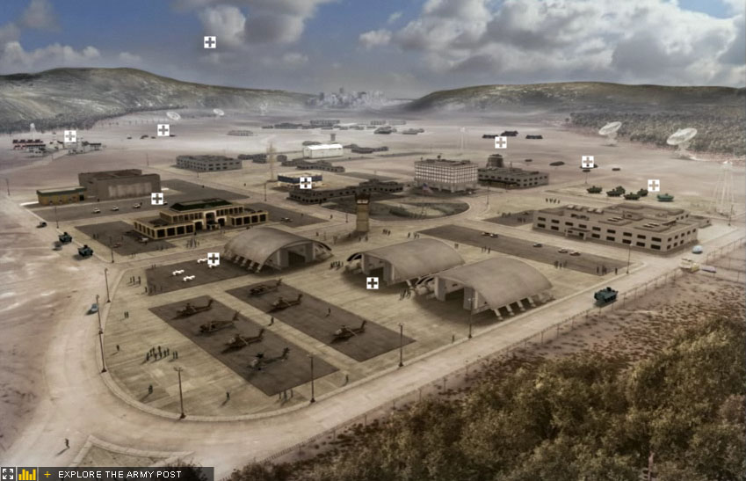


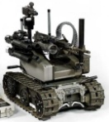






Program Summary: Operational Concept description
JIPS OV-1
GIG
SWORDS UGV
C2 Station
SWORDS UGV
Stronghold Sensor Suite
ENGAGE
6
Notes:
This OV-1 for JIPS shows a notional use case scenario. The JIPs shall protect permanent and semi-permanent bases in Southwest Asia from conventional and asymmetric ground attack. The C2 station will communicate with the Stronghold Sensor Suite to detect possible threats or attacks around the perimeter of the base. The command will determine if the threat is real and needs to be addressed based on all available information (including intel from the GIG). The SWORDS (or MAARS) UGV system will then be remotely controlled to engage and neutralize the threat. Through the use of integrating stationary sensors and UGVs, the command will have exceptional situational awareness and ability to respond to threats.

Slide 7
Program Summary: Overall Goals – manufacturing & development
DAG,DoD 5000.2
Develop a system or an increment of capability
Complete Full system Integration
Develop an affordable and executable system and affordable manufacturing process
Ensure operational supportability with particular attention to minimize
Implement Human Systems Integration
Design for producibility
System Capability and Manufacturing Process Demonstration
Effectively Integrates the Acquisition, Engineering, and Manufacturing development processes with T&E
MSB decision before EMD begins
7
Notes:
https://acc.dau.mil/CommunityBrowser.aspx?id=332538

Slide 8
Systems engineering process Approach
Stronghold and SWORDS are, themselves, non-trivial systems that require a System of Systems (SoS) approach to Systems Engineering. The process described is based on the “Systems Engineering Guide for Systems of Systems: Summary” (Office of the Director, Defense Research and Engineering, 2010).
8

Slide 9
Systems engineering process Core Elements
Translate SoS capability objectives into requirements
Understand constituent systems and relationships
Assess SoS performance against capability objectives
Develop, evolve, and maintain an SoS architecture
Monitor and assess impacts of changes on SoS performance
Address SoS requirements and solution options
Orchestrate upgrades to SoS.
9
Notes:
This is the top down portion, describing the overall project objectives independent of the systems involved.
This provides the basis for mapping boundaries and interfaces into a coherent system of systems.
Fitness to purpose must be evaluated along the way to ensure that TPMs are being met.
The resulting architecture formed by the composition of the constituent systems and guided by the program objectives becomes the new baseline architecture.
Since the systems that comprise our SoS are, themselves, programs, we must be aware of the impact to changes in these systems.
This is an attempt to balance the needs of the systems and the SoS, since they may not map exactly.
Performed in conjunction with the previous items, SoS engineer works with the systems to identify needs and address issues of implementation.

Slide 10
Systems engineering process Crosscutting Issues
Include organizational issues in systems engineering decisions.
Acknowledge roles of system-level systems engineers.
Conduct balanced technical management.
Use an architecture based on open systems and loose coupling.
Focus on design strategy and trades.
10
Notes:
In addition to the technical functionalities, interrelationships, and dependencies, a good SoS engineer will also consider the objectives, motivations, and plans of the systems that comprise the SoS. This helps with items 6 & 7 (above).
This is a form of “engineering delegation” where the SoS engineers focus on the objectives and areas critical to the SoS and leave the system-level issues to their systems engineers.
It is critical to resist the urge to involve system-level engineers in all of the aspects of SoS engineering. This is not practical and may damage the development of the constituent systems.
This significantly eases the integration burden because it normalizes the interaction and communication among systems.
The focus of SoS is often on evolutionary design and incremental delivery of capabilities.

Slide 11
Medium and High risk areas
5
4 |  | 2,3 |  | 4
3
2 |  |  |  |  | 1
1
 | 1 | 2 | 3 | 4 | 5
Impact
Risks
1: Schedule (Medium)
2: Integration (Medium)
3: Funding (Medium)
4: Joint Communications (High)
Probability
High Risk
Medium Risk
Low Risk
11
Notes:
This slide shows some of the medium and high risk areas. The programmatic, schedule, cost, and technical risks involved in the execution of this plan will be managed very closely, and as risks materialize or new risks are identified, the team will work to understand, mitigate and overcome these risks. The team is mitigating program risk by tracking the progress and improvements, as well as collecting data from tests and demonstrations that have been conducted by Army Research Laboratory (ARL), TARDEC, and DARPA.

Slide 12
High risk areas
Risk Category | # | Description | Mitigation
Medium | 1 | If the schedule has any unforeseen obstacles, the fielding schedule will move to the right. | Schedule frequent IPTs to review, monitor, and track progress. Schedule production in parallel with First Article Testing.
Medium | 2 | If there are integration issues, additional effort will be required, and the fielding schedule will not be met. | Have tight coordination and reviews to ensure that interfaces and information flow prior to testing.
Medium | 3 | If funding is not provided when needed, production could stop, and the fielding schedule will move to the right. | Provide incremental funding.
High | 4 | If detection activity data cannot be transmitted in correct format to other joint forces, the base could be left vulnerable. | Create redundancies.
12
Notes:
In order to respond to the perception that new starts seem to "take forever," the JROC established a 2016 fielding goal for the initial JIPS configuration. In order to minimize fielding gaps, the acquisition schedule was developed using very aggressive timelines for the acquisition process. So in consequence, any unforeseen obstacles, the fielding schedule will move to the right. In order to mitigate this risk, there needs to be frequent IPTs to review, monitor, and track progress. Also, production can be scheduled simultaneously with First Article Testing for extra cusion.
Because these are COTS systems developed by different contractors in different countries, there may be some integration issues. To mitigate this risk, there needs to be tight coordination and multiple reviews to ensure that interfaces and information flow prior to testing. And as we said previously, data also needs to be collected from previous test and demonstrations performed by ARL, TARDEC, and DARPA.
Because of the nature of this project and because funding is necessary to have any work completed, incremental funding needs to be used.
The system has an additional requirement to provide raw and processed sensor information to a broader joint community of tactical and strategic users in near real time; however, there is limited capability to automatically integrate and interpret relevant information to provide timely situational understanding because detected activity data is not all in a format that is mutually supported throughout the joint force and agencies, and there is no standardized equipment or procedures for all Services and agencies to link resources and information. To mitigate this risk, we need to create redundancies to ensure that all Services and agencies to link resources and information.

Slide 13
Recommended general approaches
Weekly Systems Engineering IPT
Weekly Product Assurance, Test and Configuration Management IPT
Identify components to be modified
Information Assurance
Integration phase will take place in accordance with the Integrated Master Schedule (IMS)
On-line Information Interchange System (OIIS)
Integration Testing Approach
Production Testing Approach
13
Notes:
1. There will be a weekly Systems Engineering IPT to:
Ensure the accurate and successful completion of system support objectives and other engineering, technical, and configuration requirements
Assist the project manager in executing the systems engineering processes outlined in the Cerberus SEP
Provide risk management assessment and recommend risk mitigations
2. There will be a weekly Product Assurance, Test and Configuration Management IPT to:
ensure the accurate and successful completion of system test and Configuration Management requirements
Assist the project manager in executing system test and Configuration Management processes
Audit engineering documentation (drawings and specifications), audit test activities (test procedures, set-ups, and data) and concur on test plans and procedures, configuration control activities, and completion of the verification process.
Evaluate the impact of requirement changes to testing procedures and analysis as necessary
Coordinate with test organizations to ensure proper test equipment and facilities are available to ensure proper tests are conducted on schedule
Provide risk management assessment and recommend risk mitigations
3. Identify the components that will need to be modified in order to integrate the Stronghold sensor suite and C2 station, and a set of SWORDS.
4. All security-related COTS hardware, firmware, and software components required to protect Information Systems will need be evaluated and validated in accordance with appropriate criteria, schemes, or protection profiles
5. The IMS should identify all reviews, testing, and training activities.
6. The On-line Information Interchange System (OIIS) will provide the Government access to engineering data, specifications, software metrics, subsystem test data, test procedures, the Master Schedule, and other data.
7. Finalize Integration Testing approach and integration testing activities to meet the first delivery dates.
8. Finalize Production Testing Approach. Testing approaches and activities will cover:
ATEC Readiness Testing
First Article Testing (FAT)
Approach for production in parallel with FAT
Production Acceptance Testing (PAT)
Production Verification and Validation

Slide 14

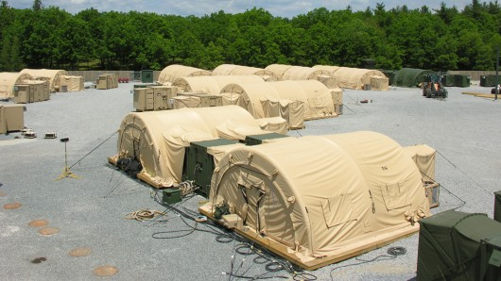
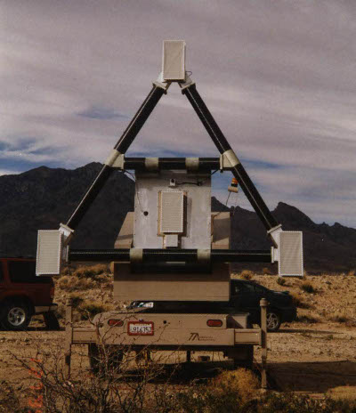
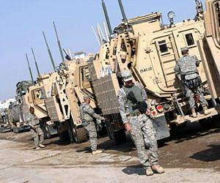
Design team organization
PM-JIPS (Program Office)
Systems Engineering Lead
Technology Implementation IPT
User Acceptability IPT
Life-Cycle Sustainability IPT
System Aspect Development Groups
System Physical Design Groups
Communications and Antenna Development
Robotic Drive Train Development
Sensory Perception Technology Development
System Integration
14
Notes:
As this is largely an integration of a few incumbent systems, operating symbiotically, we recommend that the design team apply a hierarchy based organizational approach that would ensure collaboration amongst the technologists and the IPTs focusing on achieving proper implementation of technology, acceptance by the end user, and sustainability of the JIPS as a whole.

Slide 15
Recommended tools
Recommend the use of the SPAWAR Reserve Robotics Mission to support the JIPS unmanned systems development:
SPAWAR RRM provides
Operational, technical and programmatic assistance to its customers
Training to civilian DoD, “First-Responder”, and Law enforcement personnel that operate unmanned robotic systems
Test and evaluation management to evaluate new and existing systems
Leveraging unmanned vehicle research performed in academia, such as:
Autononmous Aerial Vehicle Team at Virginia Tech
Autonomous Vehicles Laboratory at the University of Texas
15
Notes:
We recommend the use of the SPAWAR Reserve Robotics Mission to support the development of unmanned systems for the JIPS program.
SPAWAR RRM may provide operational assistance in the form of training military units with deployed assets. Technical assistance by maintaining and repairing existing systems and supporting the adoption of new systems. And also programmatic assistance by preparing contracts and documentation, as well as supporting conferences.
SPAWAR RRM has also provided training to DoD components such as NAVEOD Tech Group One, First Responder exercises such as the Oklahoma City Disaster Response Exercise, and law enforcement agencies such as the Las Vegas Metro Police Department, and the United States Border Patrol.
SPAWAR RRM supports robotic system programs through local fieldings and demonstrations, and events such as the Unmanned Systems Conferece and the Border Patrol Confered in Montana.
We also recommend that the program office leverage academia to ensure that the latest technology and sensor suites be applied to their systems. Historically, universities have been an invaluable pool of knowledge, and have provided innovative solutions for the DoD in the development of robotic systems.

Slide 16
Aspects requiring special attention
Post MSB Transition Plan
Define other Documents needed for MSB
Test and Evaluation Master Plan, Acquisition Strategy, etc
Technical Review Criteria
PDR, CDR, TRR, etc
Risk
Schedule
Integration
Funding
Joint Communications
16
Notes:
Schedule, Integration, Funding, and Joint Communications Risks were all described on a previous slide. Each risk has a mitigation strategy to ensure that programmatic, schedule, cost, and technical risks are tackled.

